Slide 1
DANIEL IN CAPTIVITY
Daniel 1:1-20

Slide 2
Temptation To COMPROMISE
“Compromise” is NOT a bad word!
See 1 Corinthians 9:19-22
Daniel submitted to MANY changes.
To A Point! [1:8]
Still, Would Have Been So Easy To Surrender!
Greatness of Babylon

Slide 3
Splendor Of Capital Of Ancient World!

Slide 4
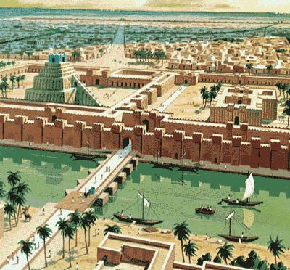

Slide 5
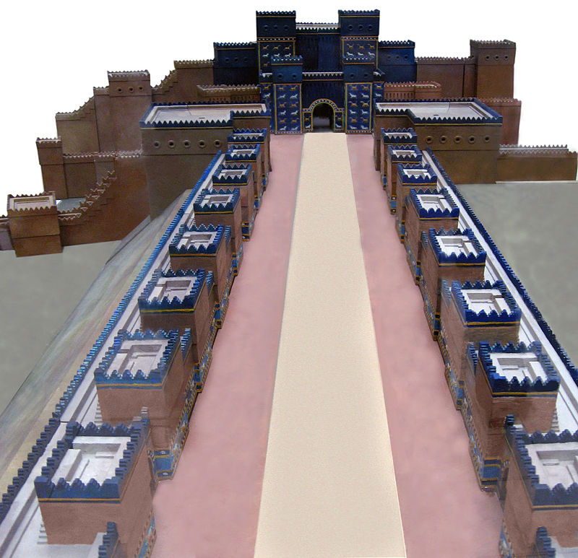

Slide 6
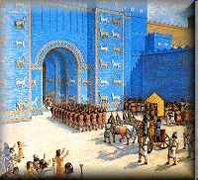
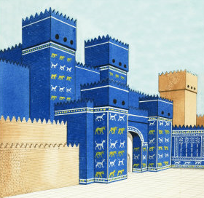

Slide 7
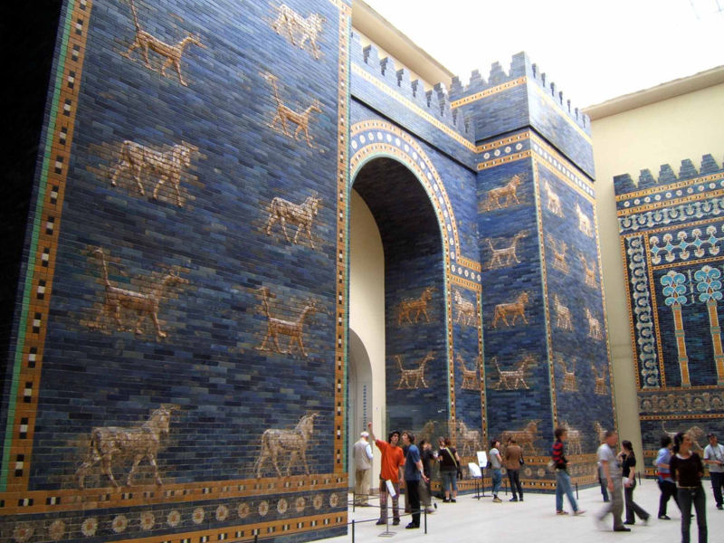

Slide 8
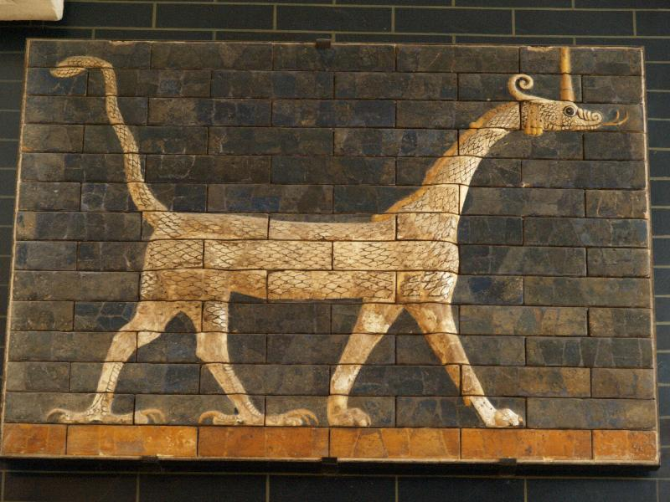
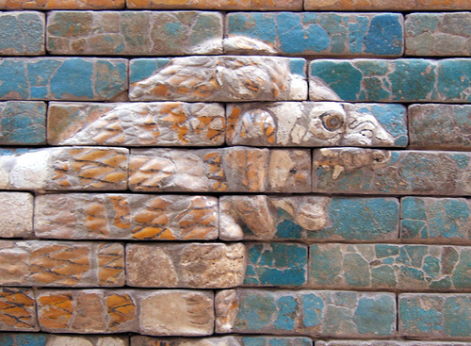
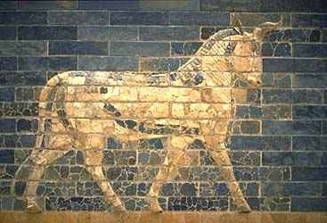

Slide 9
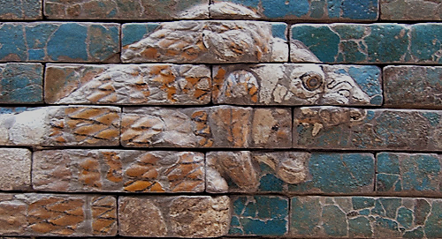

Slide 10
Temptation To COMPROMISE
“Compromise” is NOT a bad word!
To A Point! [1:8]
Still, Would Have Been So Easy To Surrender!
Greatness of Babylon!
Daniel so young, far from home.
Such A “SMALL” thing.
Know “CAN’T WIN!”

Slide 11
Yet, Daniel DID “Win”!
No matter how great our enemies, with GOD leading us we ought NEVER to be intimidated.
Even young teen can, MUST stand. Whether home or away, stand for OWN convictions.
Nothing SMALL about GOD’S will. One defeat leads to another!
Victories lost because FAILED TO TRY!
DANIEL DID NOT COMPROMISE GOD’S PRINCIPLES

Slide 12
Temptation To Be SELF-RIGHTEOUS
“I’m right and proud of it.” Good works without love.
Pharisee praying at Temple [Luke 18:9-14].
Lost sons [Luke 15:29ff.].
Simon the Pharisee [Luke 7:36ff.].
Equate being EXALTED with LOOKING DOWN on others.
Such despising of others makes one obnoxious.

Slide 13
Such NOT Case With Daniel!
“…He asked the chief of the eunuchs to allow him not to defile himself. And God gave Daniel favor and compassion in the sight of the chief of the eunuchs” [Daniel 1:8-9 RSV].
“Prove thy servants, I beseech thee, ten days; and let them give us pulse to eat, and water to drink. Then let our countenances be looked upon before thee, and the countenance of the children that eat of the portion of the king’s meat: and as thou seest, deal with thy servants” [vv.12-13].

Slide 14
Daniel Chose To Do RIGHT...
Without being condescending, arrogant or hateful.
Such would not have evoked “favor and sympathy” of Babylonians!
He showed spirit of meekness and restraint.
He shows US the way.

Slide 15
WE Are Also Strangers In Captivity!
Satan tempts us to COMPROMISE OUR PRINCIPLES!
As INDIVIDUALS:
YOUNG PEOPLE today must dare to be different!
PARENTS must also overcome pressure of conformity!

Slide 16
WE Are Also Strangers In Captivity!
Satan tempts us to COMPROMISE OUR PRINCIPLES!
As CONGREGATIONS:
Evangelism Or “Marketing”?
“Work Of Church” Or PLAY Of Church?
Compromise Doctrine?

Slide 17
For Example— METHODIST DOCTRINE ON DIVORCE AND REMARRIAGE
[The Doctrines And Discipline Of The Methodist Episcopal Church – 1896]
“No divorce, except for adultery, shall be regarded by the Church as lawful; and no Minister shall solemnize marriage in any case where there is a divorced wife or husband living; but this rule shall not be applied to the innocent party to a divorce for the cause of adultery, nor to divorced parties seeking to be reunited in marriage.”

Slide 18
The Doctrines And Discipline Of The Methodist Episcopal Church, South – 1914
“The Ministers of our Church shall be prohibited from solemnizing the rites of matrimony between divorced persons, except in case of innocent parties who have been divorced for the one scriptural cause.”

Slide 19
The Doctrines And Discipline Of The Methodist Church – 1940
“No Minister shall solemnize the marriage of a divorced person whose wife or husband is living and unmarried; but this rule shall not apply (1) To the innocent person when it is clearly established by competent testimony that the true cause for divorce was adultery or other vicious conditions which through mental or physical cruelty or physical peril invalidated the marriage vow, nor (2)To the divorced persons seeking to be reunited in marriage.”

Slide 20
The Doctrines And Discipline Of The Methodist Church – 1960
“In view of the seriousness with which the Scriptures and the Church regard divorce, a minister may solemnize the marriage of a divorced person only when he has satisfied himself by careful counseling that (a) The divorced person is sufficiently aware of the factors leading to the failure of the previous marriage, (b) The divorced person is sincerely preparing to make the proposed marriage truly Christian, and (c) Sufficient time has elapsed for adequate preparation and counseling.”

Slide 21
The Discipline Of The United Methodist Church – 1984
“Where marriage partners, even after thoughtful consideration and counsel, are estranged beyond reconciliation, we recognize divorce as regrettable but recognize the right of divorced persons to remarry … We encourage an active, accepting and enabling commitment of the Church and our society to minister to the members of divorced families.”

Slide 23
Revelation 2:14-16 KJV But I have a few things against thee, because thou hast there them that hold the doctrine of Balaam, who taught Balac to cast a stumblingblock before the children of Israel, to eat things sacrificed unto idols, and to commit fornication. (15) So hast thou also them that hold the doctrine of the Nicolaitans, which thing I hate.
(16) Repent; or else I will come unto thee quickly, and will fight against them with the sword of my mouth.

Slide 24
Satan Tempts Us To SELF-RIGHTEOUSNESS
We Can Be “Right” And Be LOST!
Pharisee at Temple may have said truth when boasted: “I fast twice in a week, etc.” BUT could not claim “And I love my neighbor as myself”!
Some of US have reputation for haughty spirit.
Galatians 6:1 ESV Brothers, if anyone is caught in any transgression, you who are spiritual should restore him in a spirit of gentleness. Keep watch on yourself, lest you too be tempted.
See 2 Timothy 2:24ff.

