Slide 1
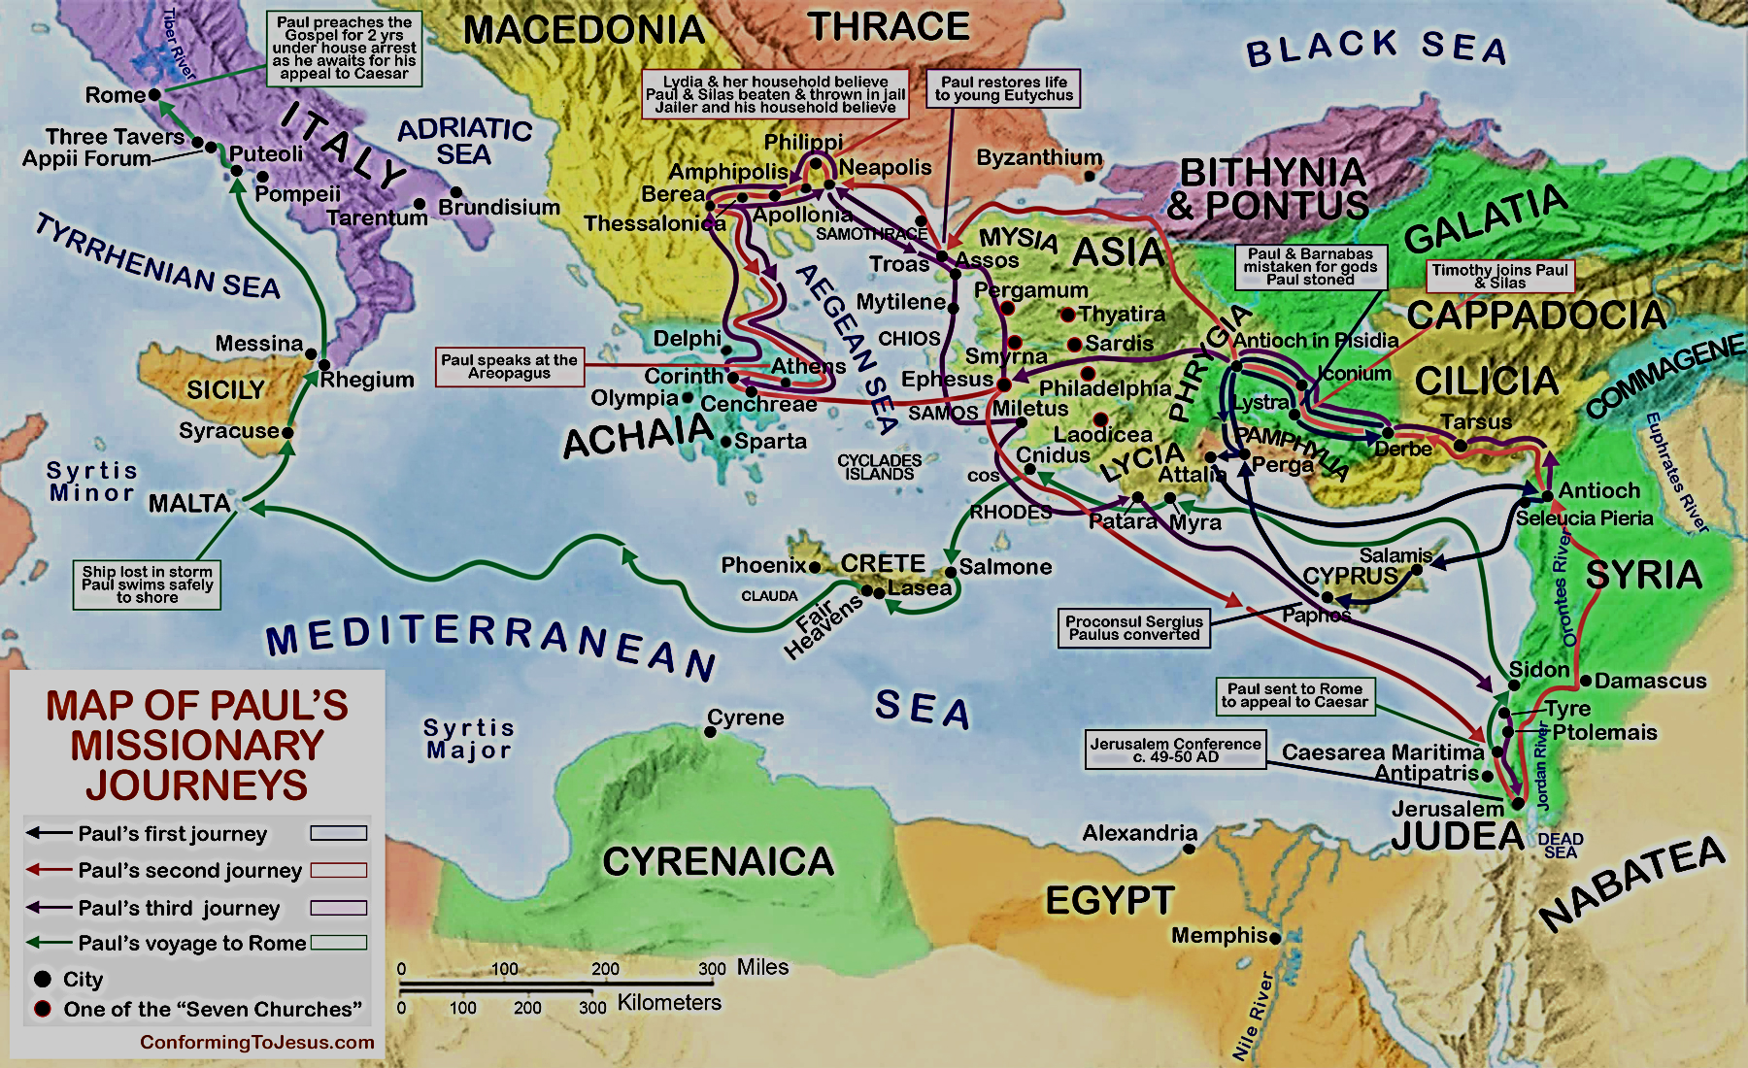

Slide 2
Troubles At Corinth & The “First Epistle”
Corinth was a troubled church!
Special problem of fornicator among their number. [1 Corinthians 5]
Paul sends letter from Ephesus. [1 Corinthians 16:8]
Planned to meet Titus at Troas, but proceeds in concern to Macedonia. [2 Corinthians 2:12-13]
Overjoyed in seeing & hearing Titus!

Slide 3
2 Corinthians 7:5-13 KJV For, when we were come into Macedonia, our flesh had no rest, but we were troubled on every side; without were fightings, within were fears. (6) Nevertheless God, that comforteth those that are cast down, comforted us by the coming of Titus; (7) And not by his coming only, but by the consolation wherewith he was comforted in you, when he told us your earnest desire, your mourning, your fervent mind toward me; so that I rejoiced the more. (8) For though I made you sorry with a letter, I do not repent, though I did repent: for I perceive that the same epistle hath made you sorry, though it were but for a season. (9) Now I rejoice, not that ye were made sorry, but that ye sorrowed to repentance: for ye were made sorry after a godly manner, that ye might receive damage by us in nothing…

Slide 4
2 Corinthians 7:5-13 KJV (10) For godly sorrow worketh repentance to salvation not to be repented of: but the sorrow of the world worketh death. (11) For behold this selfsame thing, that ye sorrowed after a godly sort, what carefulness it wrought in you, yea, what clearing of yourselves, yea, what indignation, yea, what fear, yea, what vehement desire, yea, what zeal, yea, what revenge! In all things ye have approved yourselves to be clear in this matter. (12) Wherefore, though I wrote unto you, I did it not for his cause that had done the wrong, nor for his cause that suffered wrong, but that our care for you in the sight of God might appear unto you. (13) Therefore we were comforted in your comfort: yea, and exceedingly the more joyed we for the joy of Titus, because his spirit was refreshed by you all.

Slide 5
[2 Corinthians 7:5-13]
Brought word of Corinthians change of heart toward some of their actions.
Remember “Ye are puffed up”? [1 Corinthians 5:2]
Paul’s letter has brought them to MOURNING!
“I made you sorry with a letter.” [7:8]
“Ye sorrowed to repentance.” [7:9]
“Godly sorrow worketh repentance.” [7:10]
“Ye sorrowed after a godly sort.” [7:11]

Slide 6
GODLY SORROW
Four Points From 2 Corinthians 7

Slide 7
#1. “Godly Sorrow” Results From FAITHFUL REPROOF!
2 Corinthians 7:8-9 “For though I made you sorry with a letter, I do not repent, though I did repent: for I perceive that the same epistle hath made you sorry, though it were but for a season...
Now I rejoice, not that ye were made sorry, but that ye sorrowed to repentance: for ye were made sorry after a godly manner, that ye might receive damage by us in nothing.”

Slide 8
“Godly Sorrow” Results From FAITHFUL REPROOF!
SALVATION came from the REPENTANCE that came from the GODLY SORROW that came from the PLAIN-SPOKEN REBUKE!
Paul’s words were “tough”, but effective!
Many people have been saved by means of a sermon that made them mad, but also made them think.
Impossible produce repentance without PAIN!

Slide 9
All This Has Relevance To HEARER!
If expect to go to Heaven without being corrected is a FANTASY!
Need get rid of our “touchy” attitudes and pride and get serious about being right with God! [James 3:17].
“I don’t come to be fussed at, but to be lifted up!”? Sometimes all need be “taken down!”
Prejudice (only hear from “right” people)– [John 7:45-53; 9:27-34].
Always find someone to justify us, regardless what want to do (if that is our desire!)

Slide 10
Challenge To TEACHERS 2 Timothy 4:1-5
When Christ Jesus comes as king, he will be the judge of everyone, whether they are living or dead. So with God and Christ as witnesses, I command you (2) to preach God's message. Do it willingly, even if it isn't the popular thing to do. You must correct people and point out their sins. But also cheer them up, and when you instruct them, always be patient.
(3) The time is coming when people won't listen to good teaching. Instead, they will look for teachers who will please them by telling them only what they are itching to hear. (4) They will turn from the truth and eagerly listen to senseless stories.
(5) But you must stay calm and be willing to suffer. You must work hard to tell the good news and to do your job well [CEV].

Slide 11
Consider How “Tough” It Is To Deliver Such Message!
“For out of much affliction and anguish of heart I wrote unto you with many tears . . .” [2 Cor. 2:4]
“Out of much tribulation and pressure of heart…”
Paul “repented” at one point of sending the letter!
Ought never to read 1 Corinthians without seeing the tear stains! (Do the HARD thing!)

Slide 12
#2. GODLY SORROW Is Different From “Sorrow Of World”
See 2 Corinthians 7:10.
There IS a “SORROW” that IMPENITENT know!
Sorry I got caught.
Sorry for embarrassment I am suffering.
Sorry I will have to pay a penalty.
Such sorrow makes nothing better. Leads to bitterness, self-destruction.
Selfish sorrow does not properly consider GOD!

Slide 13
PSALM 51:1-4
1 Have mercy upon me, O God, according to thy loving-kindness: according unto the multitude of thy tender mercies blot out my transgressions.
2 Wash me thoroughly from mine iniquity, and cleanse me from my sin.
3 For I acknowledge my transgressions: and my sin is ever before me.
4 Against thee, thee only, have I sinned, and done this evil in thy sight: that thou mightest be justified when thou speakest, and be clear when thou judgest.

Slide 14
#3. GODLY SORROW Demands Change!
See 2 Corinthians 7:11
“What Carefulness!”
“What Clearing Of Yourselves!”
“What Indignation!”
“What Fear!”
“What Vehement Desire!”
“What Zeal!”
“What Revenge!”
Do we display FRUITS of GODLY SORROW?

Slide 15
#4. Repentance Ought To Be Followed By FORGIVENESS!
See 2 Corinthians 2:6-11.
When one has shown fruit of repentance, it is a great discouragement to continue to hold them guilty.
No man ought to think himself more scrupulous than God.

Slide 16
James 4:6-10
... God resisteth the proud, but giveth grace unto the humble.
(7) Submit yourselves therefore to God. Resist the devil, and he will flee from you.
(8) Draw nigh to God, and he will draw nigh to you. Cleanse your hands, ye sinners; and purify your hearts, ye double minded.
(9) Be afflicted, and mourn, and weep: let your laughter be turned to mourning, and your joy to heaviness.
(10) Humble yourselves in the sight of the Lord, and he shall lift you up.

