Slide 1
“NO CONDEMNATION!”
Romans 8:1

Slide 2
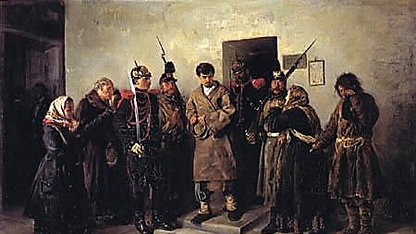

Slide 3
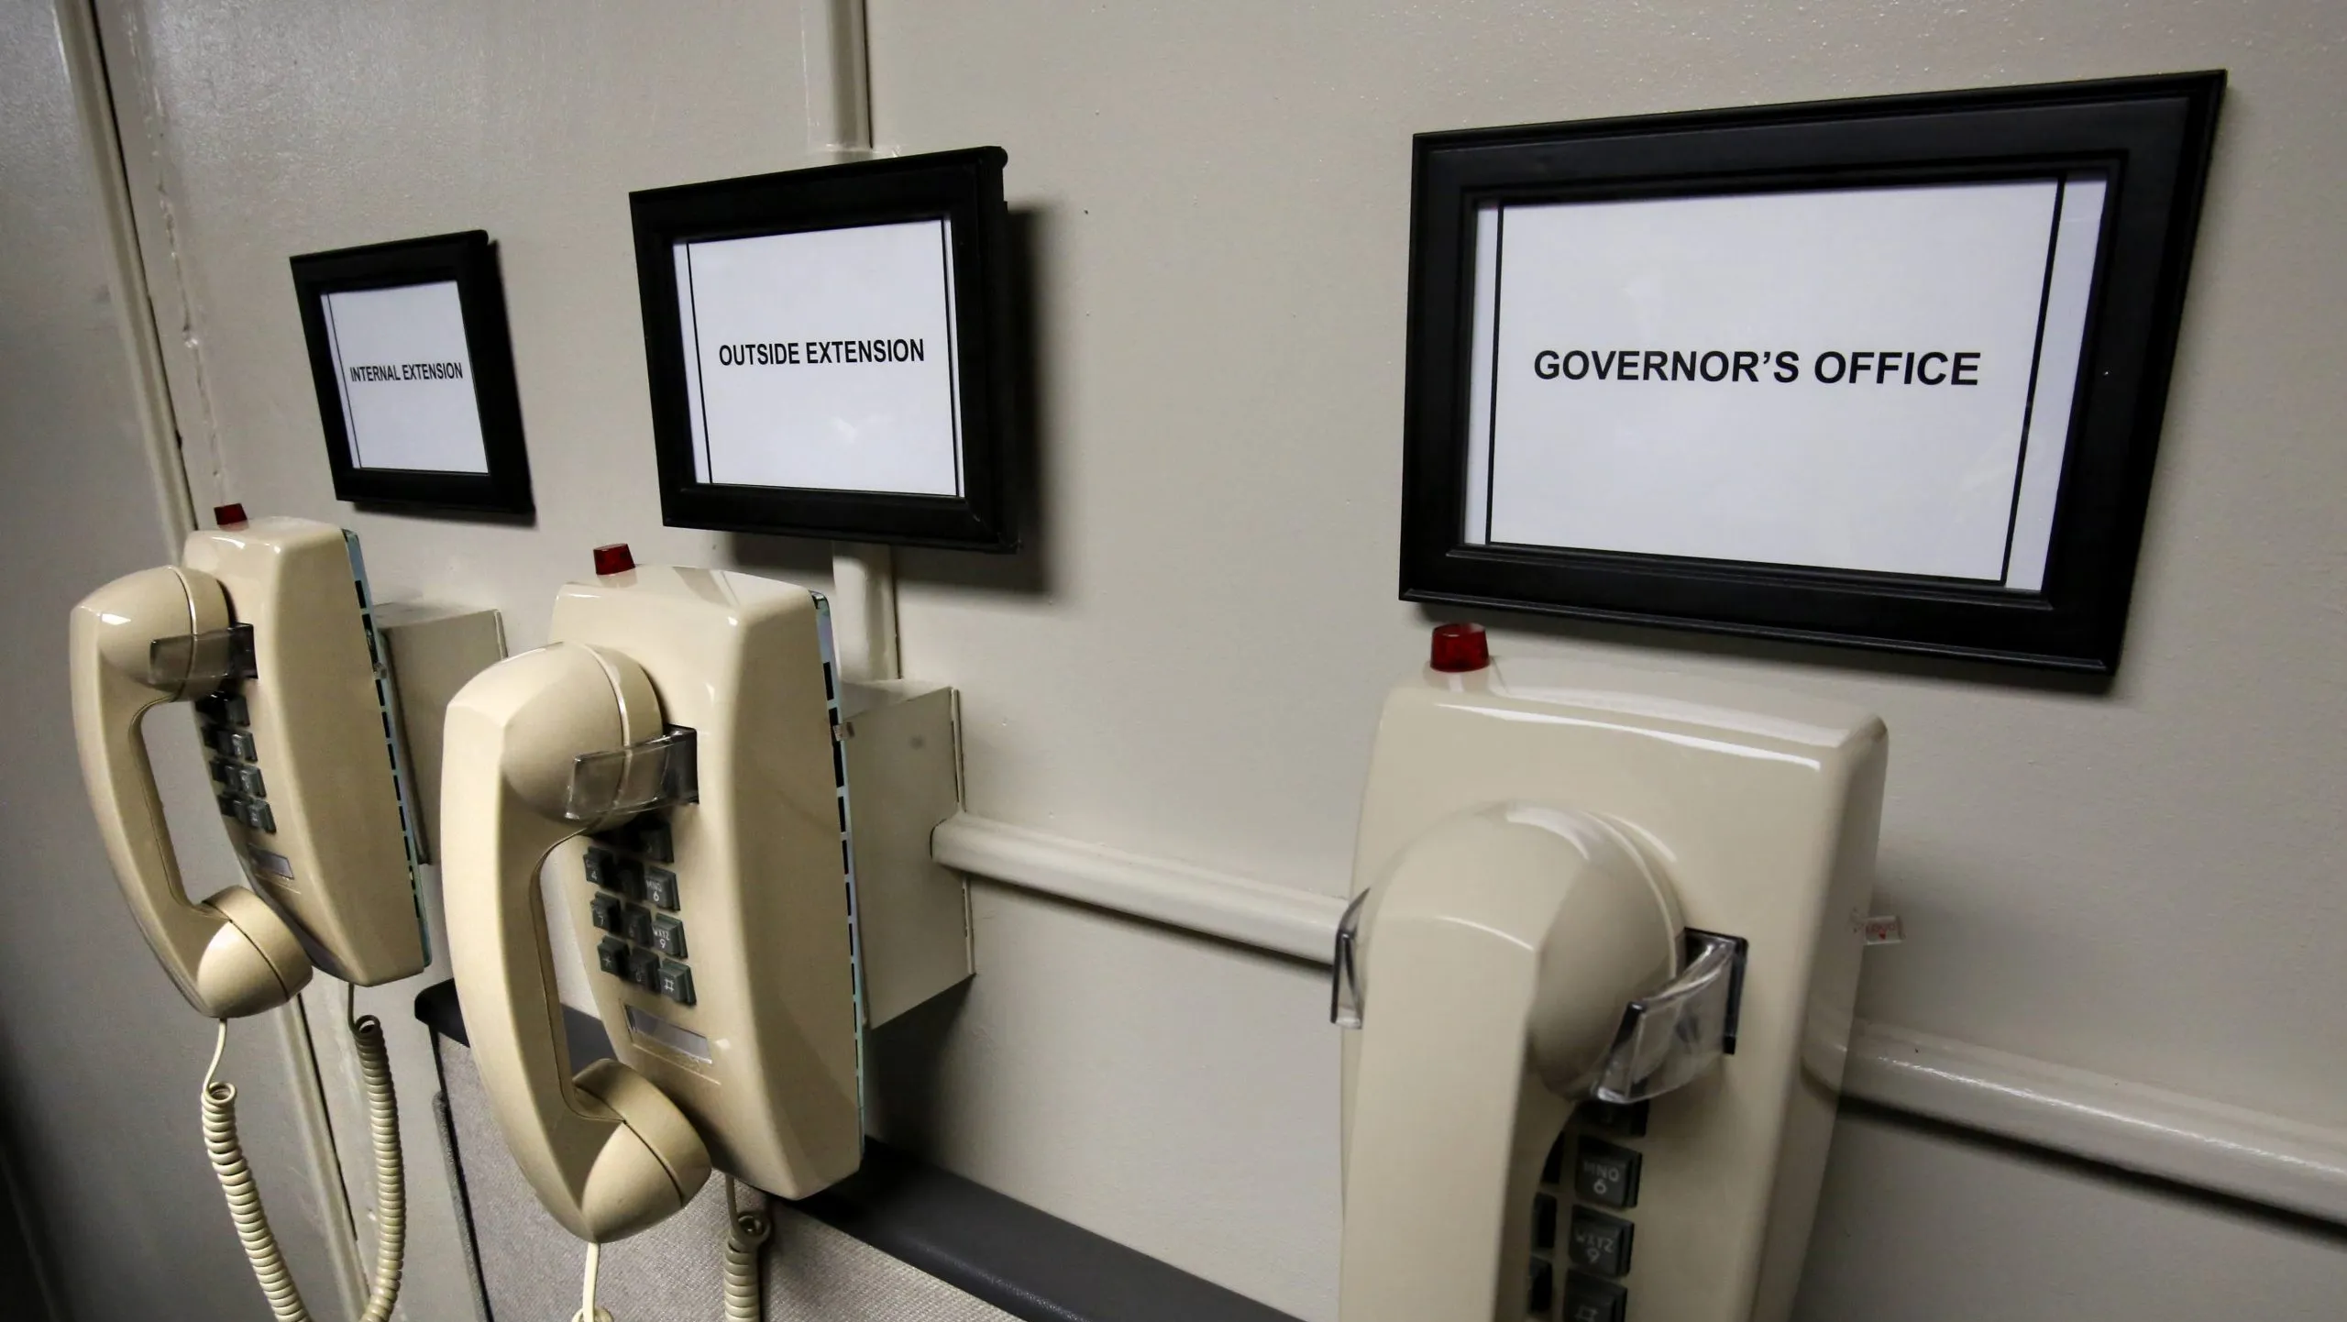

Slide 4
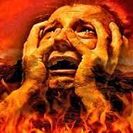

Slide 6
Romans 5:15 NKJV But the free gift is not like the offense. For if by the one man's offense many died, much more the grace of God and the gift by the grace of the one Man, Jesus Christ, abounded to many.

Slide 9
Romans 4:4-8 KJV Now to him that worketh is the reward not reckoned of grace, but of debt. (5) But to him that worketh not, but believeth on him that justifieth the ungodly, his faith is counted for righteousness. (6) Even as David also describeth the blessedness of the man, unto whom God imputeth righteousness without works, (7) Saying, Blessed are they whose iniquities are forgiven, and whose sins are covered. (8) Blessed is the man to whom the Lord will not impute sin. Cf. [Psalm 32] [Gal. 3:10]

Slide 10
NOTE TO WHOM PROMISE MADE...
[v.1] “IN Christ” [Rom. 10:9-10; 6:1-4] [Gal. 3:26-27].
[v.1, 4] “WALK after Spirit” [Galatians 5:22-25].
[v.5] “MIND things of Spirit” [Romans 8:6-8].
[v.13] “Through Spirit, MORTIFY deeds of body” [Colossians 3:5-11] [Romans 6:11-13, 20-22].
[v.14] “LED by Spirit of God” [John 15:26-27; 16:13] [Acts 2:42] [1 Cor. 2:9-13] [Eph. 3:3-4] [2 Timothy 3:16].
[v.17] “SUFFER with Christ” [2 Tim. 3:12].
[v.25] WAIT PATIENTLY in pain [Romans 2:7].

Slide 11
HEAR GLORIOUS NEWS!
We Are Free From Our Guilt! [vv. 1-4].

Slide 12
“WE ARE NOT SAVED BY ANY LAW!”??
“How can any LAW (set of rules) save anyone who does not keep them perfectly?”
Teachers among brethren who taught their students that NO LAW can save us [cf. 3:28—no article].
Short step from saying “We Are Not Saved By Any Law” to “We Are Not Under Any Law!”
Romans 8:2 GNB For the law of the Spirit, which brings us life in union with Christ Jesus, has set me free from the law of sin and death.
Fact: “LAW” is not just PRECEPTS & PENALTIES, but also the REMEDY.

Slide 13
“No Condemnation”!? Not as SIMPLE as some might think.
God gave a good law (Not kill, steal, covet, etc.).
PROBLEM: It was NOT KEPT!
“Then just send guilty to torment!”
God LOVES US.
“Then God can JUST FORGET sin!”
But God is JUST and PURE!
HOW can you reconcile God’s JUSTICE & God’s LOVE??
Answer: [Romans 3:23ff] [Romans 5:6-8].

Slide 14
We Are FREE Indeed!
Psalms 103:12 KJV As far as the east is from the west, so far hath he removed our transgressions from us.
Micah 7:19 KJV He will turn again, he will have compassion upon us; he will subdue our iniquities; and thou wilt cast all their sins into the depths of the sea.
Hebrews 8:12 KJV For I will be merciful to their unrighteousness, and their sins and their iniquities will I remember no more.

Slide 15
HEAR GLORIOUS NEWS!
We Are Free From Our Guilt! [vv. 1-4].
We Are The FOCUS Of God’s Love! [vv. 9-17].

Slide 17
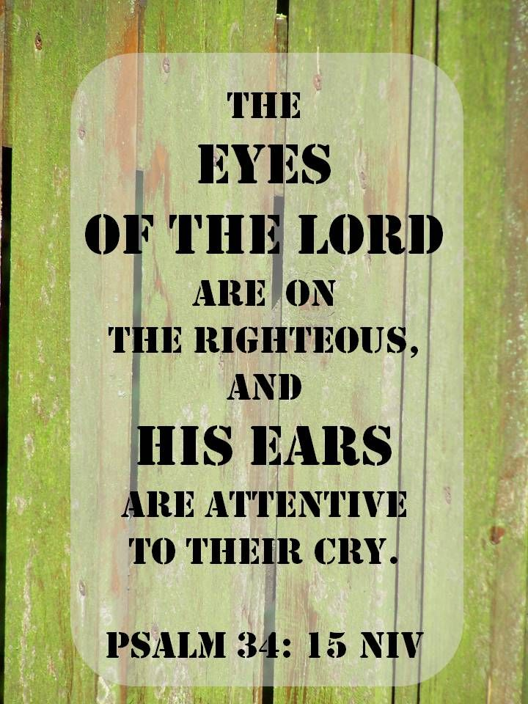

Slide 18
The godhead works on our behalf!
THE FATHER
[v.14] Sons of God.
[v.15] You have received a spirit of adoption, whereby we cry, Abba, Father.
[v.28] “All things work together for good…”
THE SON
[v.17] Heirs of God … Joint-heirs with Christ. [Cp. Rev. 3:21].
[v.34] At the right hand of God making intercession for us [Cp. Heb. 7:25].
THE HOLY SPIRIT
[v.9] The Spirit of God dwell in you …If any man hath (not) the Spirit of Christ.
[v.11] If the Spirit of Him that raised up Jesus from the dead dwell in you … By His Spirit that dwells in you. [1 Cor. 6:19-20].
[v.16] The Spirit bears witness with our spirit that we are children of God.

Slide 19
Romans 8:26-27
Likewise the Spirit also helpeth our infirmities: for we know not what we should pray for as we ought: but the Spirit himself maketh intercession for us with groanings which cannot be uttered.
And he that searcheth the hearts knoweth what is the mind of the Spirit, because he maketh intercession for the saints according to the will of God.

Slide 20
Romans 8:31 KJV What shall we then say to these things? If God be for us, who can be against us?

Slide 21
Ephesians 2:1-6 NKJV And you He made alive, who were dead in trespasses and sins, (2) in which you once walked according to the course of this world, according to the prince of the power of the air, the spirit who now works in the sons of disobedience, (3) among whom also we all once conducted ourselves in the lusts of our flesh, fulfilling the desires of the flesh and of the mind, and were by nature children of wrath, just as the others. (4) But God, who is rich in mercy, because of His great love with which He loved us, (5) even when we were dead in trespasses, made us alive together with Christ (by grace you have been saved), (6) and raised us up together, and made us sit together in the heavenly places in Christ Jesus…

Slide 22
Ephesians 2:19-22 KJV Now therefore ye are no more strangers and foreigners, but fellowcitizens with the saints, and of the household of God; (20) And are built upon the foundation of the apostles and prophets, Jesus Christ himself being the chief corner stone; (21) In whom all the building fitly framed together groweth unto an holy temple in the Lord: (22) In whom ye also are builded together for an habitation of God through the Spirit.

Slide 23
Matthew 6:25-30 NKJV "Therefore I say to you, do not worry about your life, what you will eat or what you will drink; nor about your body, what you will put on. Is not life more than food and the body more than clothing? (26) Look at the birds of the air, for they neither sow nor reap nor gather into barns; yet your heavenly Father feeds them. Are you not of more value than they? (27) Which of you by worrying can add one cubit to his stature? (28) "So why do you worry about clothing? Consider the lilies of the field, how they grow: they neither toil nor spin; (29) and yet I say to you that even Solomon in all his glory was not arrayed like one of these. (30) Now if God so clothes the grass of the field, which today is, and tomorrow is thrown into the oven, will He not much more clothe you, O you of little faith?

Slide 24
Matthew 10:27-31 KJV What I tell you in darkness, that speak ye in light: and what ye hear in the ear, that preach ye upon the housetops. (28) And fear not them which kill the body, but are not able to kill the soul: but rather fear him which is able to destroy both soul and body in hell. (29) Are not two sparrows sold for a farthing? and one of them shall not fall on the ground without your Father. (30) But the very hairs of your head are all numbered. (31) Fear ye not therefore, ye are of more value than many sparrows.

Slide 25
HEAR GLORIOUS NEWS!
We Are Free From Our Guilt! [vv.1-4].
We Are The FOCUS Of God’s Love! [vv. 9-17].
We Will Be Manifested As God’s Own! [vv.19-25].

Slide 26
Apokalupsis (Lay bear, disclose, reveal)
“The manifestation of the sons of God…”
Cp. With Colossians 3:1-4 If ye then be risen with Christ, seek those things which are above, where Christ sitteth on the right hand of God. Set your affection on things above, not on things on the earth. For ye are dead, and your life is hid with Christ in God. When Christ, who is our life, shall appear, then shall ye also appear with him in glory.

Slide 27
HEAR GLORIOUS NEWS!
We Are Free From Our Guilt! [vv.1-4].
We Are The FOCUS Of God’s Love! [vv. 9-17].
We Will Be Manifested As God’s Own! [vv.19-25].
We Are NEVER FORSAKEN By God!

Slide 28
See Romans 8:29-30
Would the God who planned our salvation…
Called us to obedience…
Justified us from our guilt…
Promises to glorify our mortal weakness...
AFTER ALL THAT, forsake His people??

Slide 29
Romans 8:32-37
(32) He that spared not his own Son, but delivered him up for us all, how shall he not with him also freely give us all things?
(33) Who shall lay any thing to the charge of God's elect? It is God that justifieth. (34) Who is he that condemneth? It is Christ that died, yea rather, that is risen again, who is even at the right hand of God, who also maketh intercession for us…
[Cf. Romans 5:8-10].

Slide 30
Romans 8:31-37
(35) Who shall separate us from the love of Christ? shall tribulation, or distress, or persecution, or famine, or nakedness, or peril, or sword?
(36) As it is written, “For thy sake we are killed all the day long; we are accounted as sheep for the slaughter.”
Cf. [Psalm 44].

Slide 31
TRUST GOD, EVEN IN DARK TIMES!
(37) Nay, in all these things we are more than conquerors through him that loved us. **[5:3] [8:28] [2 Corinthians 12:9-10]
(38) For I am persuaded, that neither death, nor life, nor angels, nor principalities, nor powers, nor things present, nor things to come,
(39) Nor height, nor depth, nor any other creature, shall be able to separate us from the love of God, which is in Christ Jesus our Lord.

Slide 32
There Is Therefore Now NO CONDEMNATION To Them Which Are In Christ Jesus, Who Walk Not After The Flesh, But After The Spirit.
Romans 8:1

