Slide 1
Matthew 27:32-54 KJV And as they came out, they found a man of Cyrene, Simon by name: him they compelled to bear his cross. (33) And when they were come unto a place called Golgotha, that is to say, a place of a skull, (34) They gave him vinegar to drink mingled with gall: and when he had tasted thereof, he would not drink. (35) And they crucified him, and parted his garments, casting lots: that it might be fulfilled which was spoken by the prophet, They parted my garments among them, and upon my vesture did they cast lots. (36) And sitting down they watched him there; (37) And set up over his head his accusation written, THIS IS JESUS THE KING OF THE JEWS.
(38) Then were there two thieves crucified with him, one on the right hand, and another on the left. (39) And they that passed by reviled him, wagging their heads, (40) And saying, Thou that destroyest the temple, and buildest it in three days, save thyself. If thou be the Son of God, come down from the cross. (41) Likewise also the chief priests mocking him, with the scribes and elders, said, (42) He saved others; himself he cannot save. If he be the King of Israel, let him now come down from the cross, and we will believe him. (43) He trusted in God; let him deliver him now, if he will have him: for he said, I am the Son of God. (44) The thieves also, which were crucified with him, cast the same in his teeth…

Slide 2
Matthew 27:32-54 KJV (45) Now from the sixth hour there was darkness over all the land unto the ninth hour. (46) And about the ninth hour Jesus cried with a loud voice, saying, Eli, Eli, lama sabachthani? that is to say, My God, my God, why hast thou forsaken me? (47) Some of them that stood there, when they heard that, said, This man calleth for Elias. (48) And straightway one of them ran, and took a sponge, and filled it with vinegar, and put it on a reed, and gave him to drink. (49) The rest said, Let be, let us see whether Elias will come to save him. (50) Jesus, when he had cried again with a loud voice, yielded up the ghost.
(51) And, behold, the veil of the temple was rent in twain from the top to the bottom; and the earth did quake, and the rocks rent; (52) And the graves were opened; and many bodies of the saints which slept arose, (53) And came out of the graves after his resurrection, and went into the holy city, and appeared unto many. (54) Now when the centurion, and they that were with him, watching Jesus, saw the earthquake, and those things that were done, they feared greatly, saying, Truly this was the Son of God.

Slide 4
See His SUFFERING…
Mark 15:25 KJV And it was the third hour, and they crucified him.

Slide 5
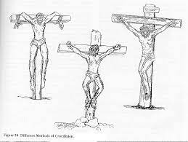

Slide 7
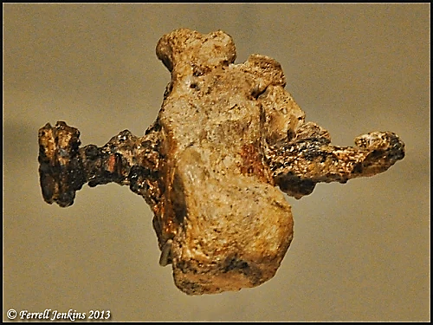
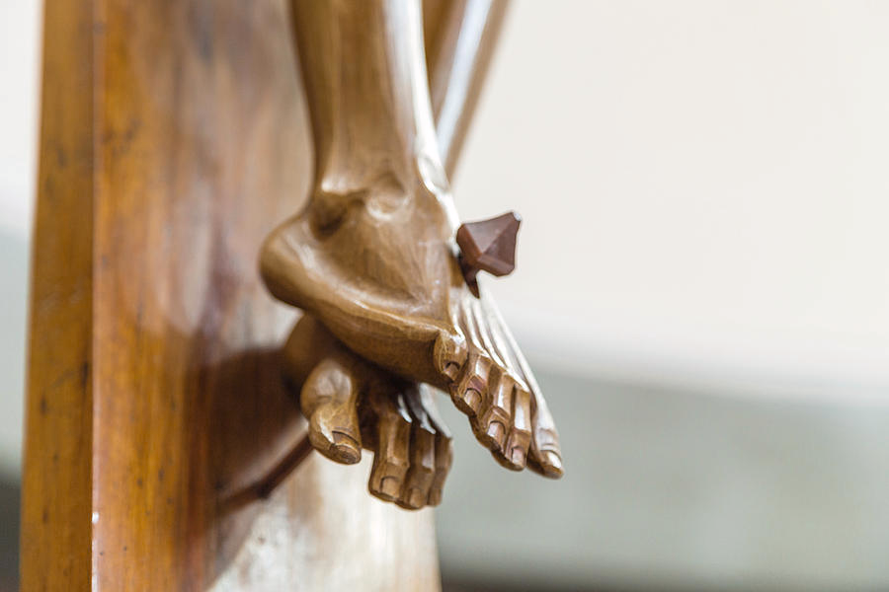
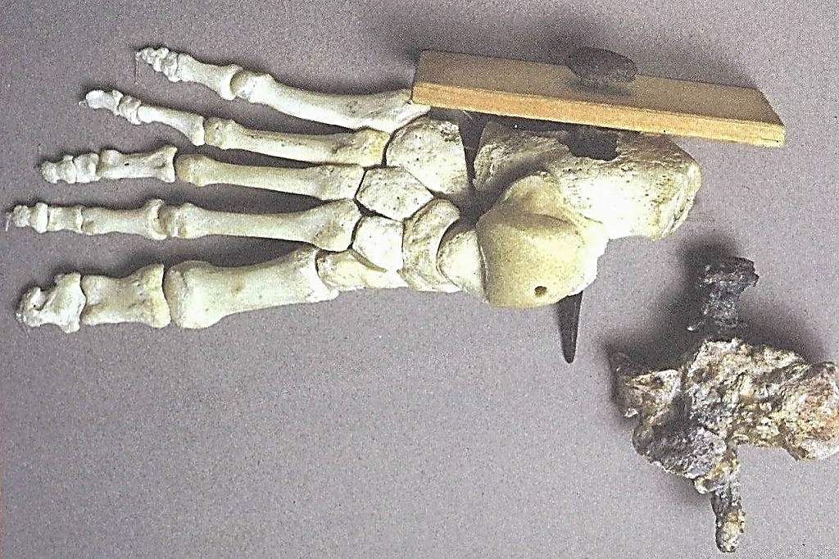
Nail through the heel bone of a man crucified outside Jerusalem in Roman times. Display in Israel Museum. Photo by Ferrell Jenkins.

Slide 8
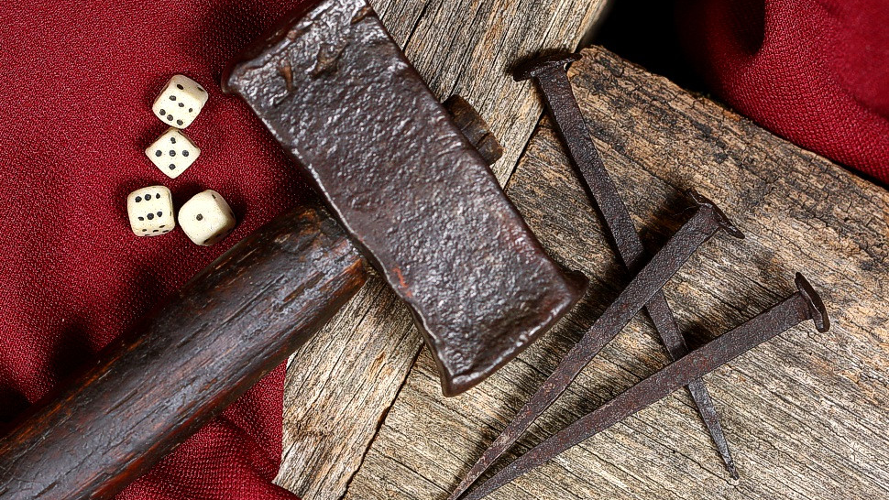
Acts 2:23 This very Jesus, I say, after He was betrayed, in accordance with the predetermined plan and foreknowledge of God, you had wicked men kill by nailing Him to a cross [Williams].

Slide 9
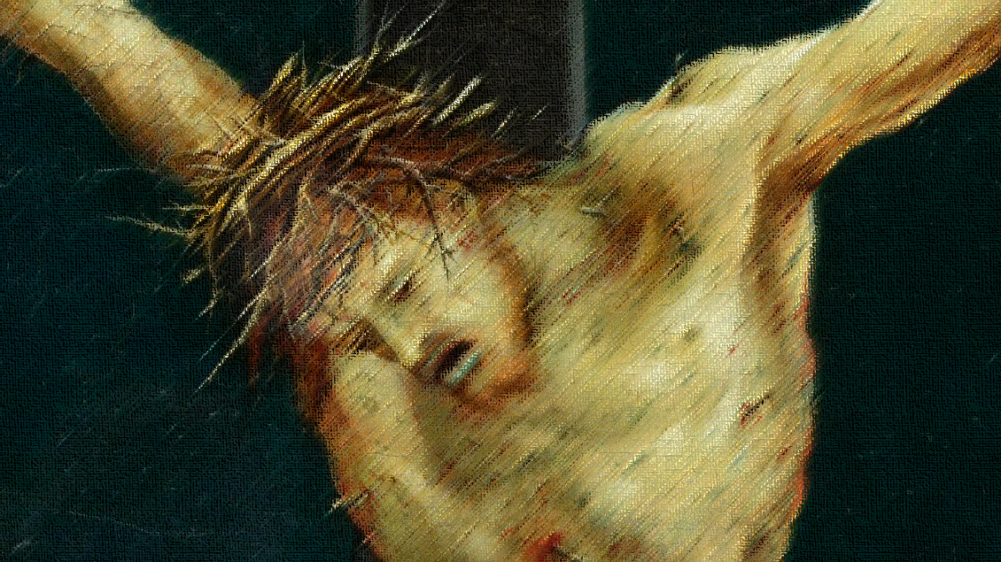
ISAIAH 53

Slide 10
Isaiah 53:5 ESV But he was pierced for our transgressions; he was crushed for our iniquities; upon him was the chastisement that brought us peace, and with his wounds we are healed.
Psalms 22:14-18 KJV I am poured out like water, and all my bones are out of joint: my heart is like wax; it is melted in the midst of my bowels. (15) My strength is dried up like a potsherd; and my tongue cleaveth to my jaws; and thou hast brought me into the dust of death. (16) For dogs have compassed me: the assembly of the wicked have inclosed me: they pierced my hands and my feet. (17) I may tell all my bones: they look and stare upon me. (18) They part my garments among them, and cast lots upon my vesture.

Slide 11
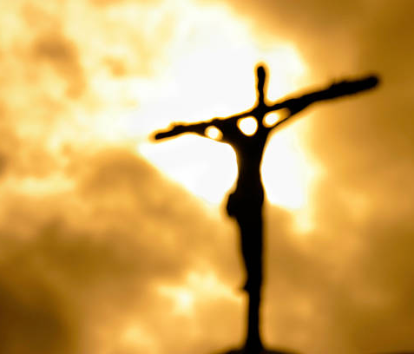
Note from ISBE: “The suffering of death by crucifixion was intense, especially in hot climates. Severe local inflammation, coupled with an insignificant bleeding of the jagged wounds, produced traumatic fever, which was aggravated by the exposure to the heat of the sun, the straining of the body and insufferable thirst.
The swelling about the rough nails and the torn lacerated tendons and nerves caused excruciating agony. The arteries of the head and stomach were surcharged with blood and a terrific throbbing headache ensued. The mind was confused and filled with anxiety and dread foreboding. The victim of crucifixion literally died a thousand deaths.”

Slide 12
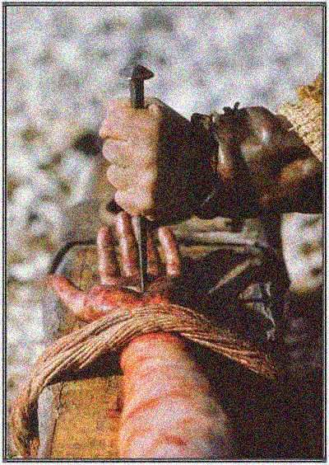
Mark tells us Jesus hung on the cross from the THIRD hour to the NINTH hour (9 AM to 3PM)– SIX HOURS!
Isaiah 53:10 KJV Yet it pleased the LORD to bruise him; he hath put him to grief: when thou shalt make his soul an offering for sin, he shall see his seed, he shall prolong his days, and the pleasure of the LORD shall prosper in his hand.
It was NOT the NAILS that kept Jesus on the cross, it was His obedience to the Father and His love for you!

Slide 13
See Jesus’ HUMILIATION
Hebrews 12:1-2 ISV Let us keep running with endurance the race set before us, (2) fixing our attention on Jesus, the pioneer and perfecter of the faith, who, in view of the joy set before him, endured the cross, disregarding its shame, and has sat down at the right hand of the throne of God.

Slide 14
Humiliation Of Being Treated As A Dangerous Criminal By Legal System!

Slide 15
Romans 13:3 KJV For rulers are not a terror to good works, but to the evil. Wilt thou then not be afraid of the power? do that which is good, and thou shalt have praise of the same:
Luke 23:4 KJV Then said Pilate to the chief priests and to the people, I find no fault in this man.
Luke 23:14-15 KJV Said unto them, Ye have brought this man unto me, as one that perverteth the people: and, behold, I, having examined him before you, have found no fault in this man touching those things whereof ye accuse him: (15) No, nor yet Herod: for I sent you to him; and, lo, nothing worthy of death is done unto him.
Luke 23:22 KJV And he said unto them the third time, Why, what evil hath he done? I have found no cause of death in him: I will therefore CHASTISE him, and let him go.

Slide 16
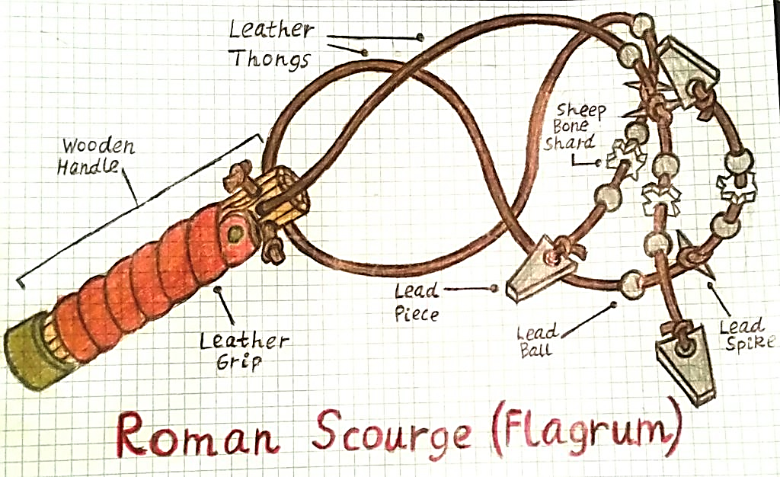
Matthew 20:19 KJV And shall deliver him to the Gentiles to mock, and to scourge…
From mastigoō (related to our word “masticate,” to chew up)—flog, whip.
Fitting because the effect would be to “chew up” the flesh on the victim’s back, legs. (Eusebius writes about the inward parts of a man being exposed by scourging).

Slide 17
Matthew 27:27-31 KJV Then the soldiers of the governor took Jesus into the common hall, and gathered unto him the whole band of soldiers. (28) And they stripped him, and put on him a scarlet robe. (29) And when they had platted a crown of thorns, they put it upon his head, and a reed in his right hand: and they bowed the knee before him, and mocked him, saying, Hail, King of the Jews! (30) And they spit upon him, and took the reed, and smote him on the head. (31) And after that they had mocked him, they took the robe off from him, and put his own raiment on him, and led him away to crucify him.

Slide 18
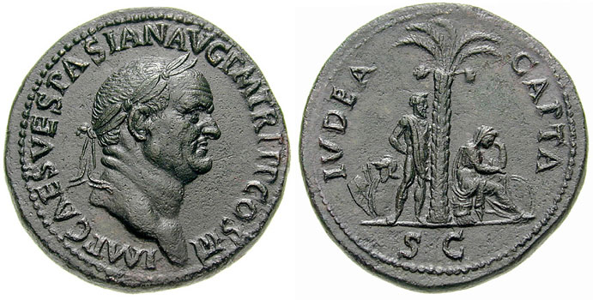

Slide 19
Humiliation Of Being Treated As A Criminal By Legal System!
Humiliation Of Being Rejected By “His Own People!”
John 1:10-11 KJV He was in the world, and the world was made by him, and the world knew him not. (11) He came unto his own, and HIS OWN RECEIVED HIM NOT.

Slide 20
Matthew 26:62-68 KJV And the high priest arose, and said unto him, Answerest thou nothing? what is it which these witness against thee? (63) But Jesus held his peace. And the high priest answered and said unto him, I adjure thee by the living God, that thou tell us whether thou be the Christ, the Son of God. (64) Jesus saith unto him, Thou hast said: nevertheless I say unto you, Hereafter shall ye see the Son of man sitting on the right hand of power, and coming in the clouds of heaven.
(65) Then the high priest rent his clothes, saying, He hath spoken blasphemy; what further need have we of witnesses? behold, now ye have heard his blasphemy. (66) What think ye? They answered and said, He is guilty of death. (67) Then did they spit in his face, and buffeted him; and others smote him with the palms of their hands, (68) Saying, Prophesy unto us, thou Christ, Who is he that smote thee?

Slide 22
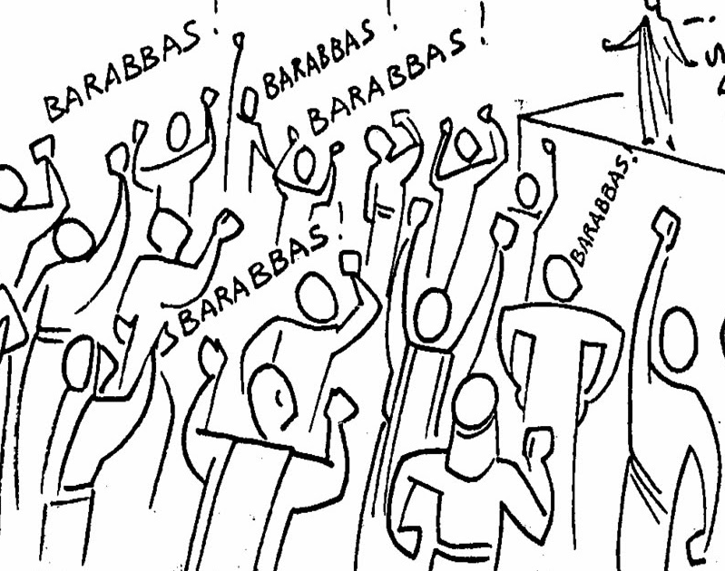
But the chief priests moved the people, that he should rather release Barabbas unto them. (12) And Pilate answered and said again unto them, What will ye then that I shall do unto him whom ye call the King of the Jews? (13) And they cried out again, Crucify him. (14) Then Pilate said unto them, Why, what evil hath he done? And they cried out the more exceedingly, Crucify him. MARK 15:11-14

Slide 23
Mark 15:29-32 GW Those who passed by insulted him. They shook their heads and said, "What a joke! You were going to tear down God's temple and build it again in three days. (30) Come down from the cross, and save yourself!"
(31) The chief priests and the scribes made fun of him among themselves in the same way. They said, "He saved others, but he can't save himself. (32) Let the Messiah, the king of Israel, come down from the cross now so that we may see and believe."
Even those who were crucified with him were insulting him.

Slide 24
Humiliation Of Being Treated As A Criminal By Legal System!
Humiliation Of Being Rejected By “His Own People!”
Humiliating Failures Of Jesus’ Own Disciples!

Slide 25
Take us back to the somber occasion of LAST Passover.
Luke 22:24 KJV And there was also a strife among them, which of them should be accounted the greatest. Cf. [John 13:1-17].
“One of YOU shall betray me!” [Is it I? Mark 14:17ff.] [Immediately after sop—John 13:30].
“This is MY BODY, BLOOD!”
“ALL of you shall FORSAKE Me” [Mark 14:27-31] [Luke 22:31-34].
Went to GETHSEMANE to pour out His agony to the Father— 3 DISCIPLES SLEPT! [Mt. 26:36-46] [“Worn out from sorrow” --Luke 22:45].
When Squad sent by Jews came to arrest Him, it was JUDAS leading the way!
When faced with the MOMENT OF CRISIS-- they all FAILED miserably!
Ultimately ran off into the night [Mark 14:51-52].
Peter, most spectacularly failed. He tried to KILL Malchus!
Peter again, as foretold, later DENIED the Lord—[Luke 22:59-62].

Slide 26
See Jesus’ LOVING MERCY

Slide 27
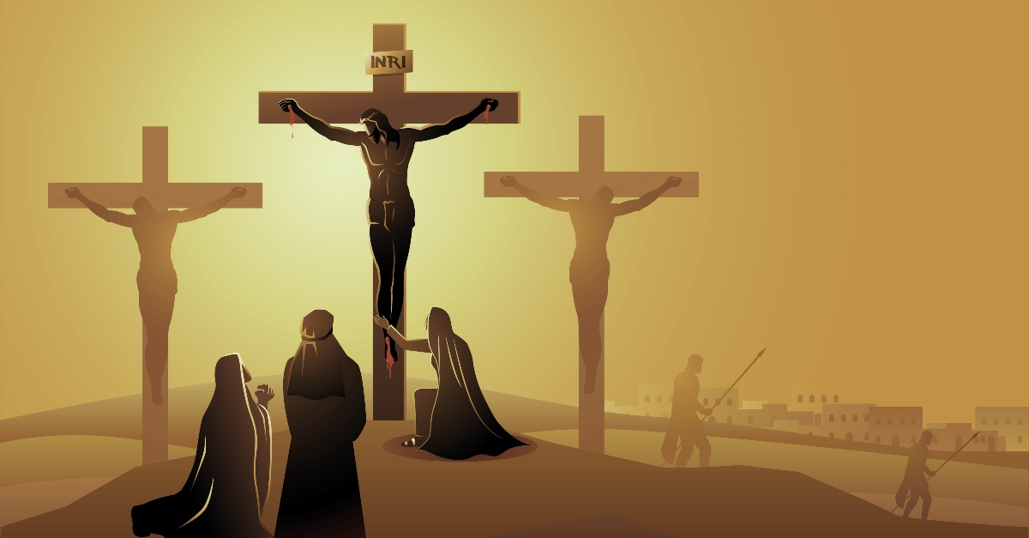
For His MOTHER (“Woman, behold thy son...”)
For the penitent THIEF (“This day… with Me in paradise.”)
For hostile MOB, mercy! (“Father, forgive them…”).
For the DISCOURAGED (Lk. 23:48-49) (Psalm 22).

Slide 28
See OUR CROSS!

Slide 30
Mark 10:17-22 KJV And when he was gone forth into the way, there came one running, and kneeled to him, and asked him, Good Master, what shall I do that I may inherit eternal life? (18) And Jesus said unto him, Why callest thou me good? there is none good but one, that is, God. (19) Thou knowest the commandments, Do not commit adultery, Do not kill, Do not steal, Do not bear false witness, Defraud not, Honour thy father and mother. (20) And he answered and said unto him, Master, all these have I observed from my youth.
(21) Then Jesus beholding him loved him, and said unto him, One thing thou lackest: go thy way, sell whatsoever thou hast, and give to the poor, and thou shalt have treasure in heaven: and come, take up the cross, and follow me. (22) And he was sad at that saying, and went away grieved: for he had great possessions.
WAS LORD TOO HARD? ASK TOO MUCH? GLAD NOT TALKING TO US??

Slide 31
Mark 8:31-38 KJV And he began to teach them, that the Son of man must suffer many things, and be rejected of the elders, and of the chief priests, and scribes, and be killed, and after three days rise again. (32) And he spake that saying openly. And Peter took him, and began to rebuke him. (33) But when he had turned about and looked on his disciples, he rebuked Peter, saying, Get thee behind me, Satan: for thou savourest not the things that be of God, but the things that be of men.
(34) And when he had called the people unto him with his disciples also, he said unto them, Whosoever will come after me, let him deny himself, and take up his cross, and follow me. (35) For whosoever will save his life shall lose it; but whosoever shall lose his life for my sake and the gospel's, the same shall save it.
(36) For what shall it profit a man, if he shall gain the whole world, and lose his own soul? (37) Or what shall a man give in exchange for his soul? (38) Whosoever therefore shall be ashamed of me and of my words in this adulterous and sinful generation; of him also shall the Son of man be ashamed, when he cometh in the glory of his Father with the holy angels.
“God Would Never Expect Us To…” YES HE DOES!

Slide 32
Matthew 10:34-39 KJV Think not that I am come to send peace on earth: I came not to send peace, but a sword. (35) For I am come to set a man at variance against his father, and the daughter against her mother, and the daughter in law against her mother in law. (36) And a man's foes shall be they of his own household.
(37) He that loveth father or mother more than me is not worthy of me: and he that loveth son or daughter more than me is not worthy of me. (38) And he that taketh not his cross, and followeth after me, is not worthy of me. (39) He that findeth his life shall lose it: and he that loseth his life for my sake shall find it.
“MY FAMILY COMES FIRST!...”

Slide 33
Mark 10:28-31 KJV Then Peter began to say unto him, Lo, we have left all, and have followed thee. (29) And Jesus answered and said, Verily I say unto you, There is no man that hath left house, or brethren, or sisters, or father, or mother, or wife, or children, or lands, for my sake, and the gospel's, (30) But he shall receive an hundredfold now in this time, houses, and brethren, and sisters, and mothers, and children, and lands, with persecutions; and in the world to come eternal life. (31) But many that are first shall be last; and the last first.

Slide 34
Luke 14:25-33 KJV And there went great multitudes with him: and he turned, and said unto them, (26) If any man come to me, and hate not his father, and mother, and wife, and children, and brethren, and sisters, yea, and his own life also, he cannot be my disciple. (27) And whosoever doth not bear his cross, and come after me, cannot be my disciple.
(28) For which of you, intending to build a tower, sitteth not down first, and counteth the cost, whether he have sufficient to finish it? (29) Lest haply, after he hath laid the foundation, and is not able to finish it, all that behold it begin to mock him, (30) Saying, This man began to build, and was not able to finish. (31) Or what king, going to make war against another king, sitteth not down first, and consulteth whether he be able with ten thousand to meet him that cometh against him with twenty thousand? (32) Or else, while the other is yet a great way off, he sendeth an ambassage, and desireth conditions of peace. (33) So likewise, whosoever he be of you that forsaketh not all that he hath, he cannot be my disciple.
ALL THE WAY, OR NOT AT ALL!

Slide 35
Hebrews 12:3-4 GW Think about Jesus, who endured opposition from sinners, so that you don't become tired and give up. (4) You struggle against sin, but your struggles haven't killed you.

