Slide 1
Hymns for Worship at Woodmont
7 Saints Lift Your Voices
4 Blessed Assurance
165 Thus Remember Me
500 Give Me the Bible
265 Faith of our Fathers
701 Walk Beside Me

Slide 2
God Provided for all of Israel’s Needs
Israel had seen God’s power over all the gods of
Egypt in delivering them from bondage and
destroying their enemies in the Red Sea.
(Exodus 6:5-6; 12:12; 14:14; 30)
God provided manna for them in the wilderness
for 40 years while Israel complained.
(Exodus 16:1-4, 31, 35)

Slide 3
Israel Promised to Obey God’s Commands
Moses called the elders of the people, & set
before them all these words which the Lord had
commanded him. All the people said, “All that
the Lord has spoken we will do!” (Ex. 19:7-8).
After the 10 commandments are given all the
people said, “All the words which the Lord has
spoken we will do!” (Ex. 24:3).

Slide 4
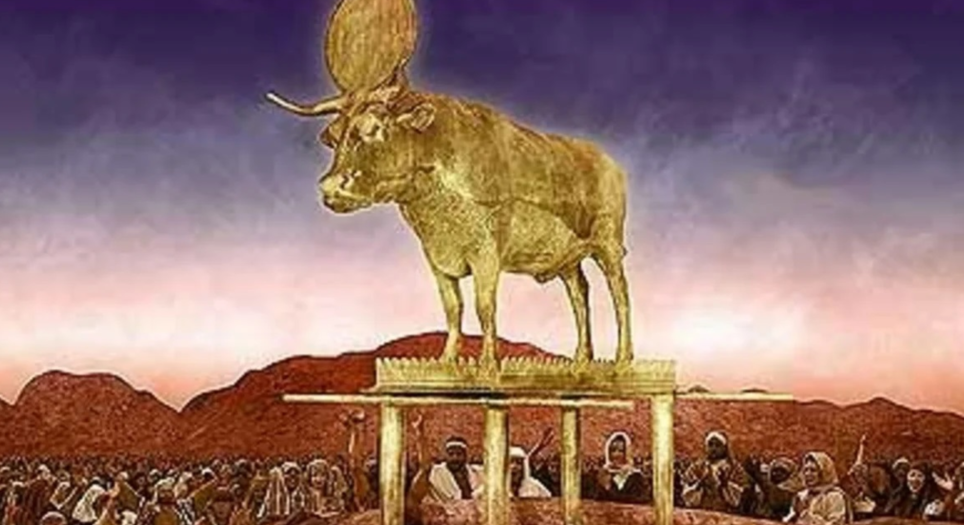
Israel’s Idolatry- Molten Calf (Ex. 32)

Slide 5
“When the people saw that Moses delayed to come
come down from the mountain, the people
assembled about Aaron & said to him,
“Come, make us a god who will go before us;
as for this Moses, the man who brought us up
from the land of Egypt, we do not know what has
become of him.” Aaron said to them, “Tear off the
gold rings which are in the ears of your wives, your
sons, & your daughters, & bring them to me.”….

Slide 6
…Then all the people tore off the gold rings which
were in their ears & brought them to Aaron.
He took this from their hand, & fashioned it with a
graving tool & made it into a molten calf;
& they said, “This is your god, O Israel, who
brought you up from the land of Egypt.”
Now when Aaron saw this, he built an altar before
it; & Aaron made a proclamation & said,
“Tomorrow shall be a feast to the Lord.”…

Slide 7
…So the next day they rose early & offered burnt
offerings, & brought peace offerings; & the people
sat down to eat & to drink, & rose up to play.
Then the Lord spoke to Moses, “Go down at once,
for your people, whom you brought up from the
land of Egypt, have corrupted themselves.
They have quickly turned aside from
the way which I commanded them”
(Exodus 32:1-8a)

Slide 8
Israel’s Idolatry- Broke Rule #1
They told Aaron to make them a god
as they quickly disobeyed God’s #1 rule,
“You shall have no other gods before Me”
(Exodus 32:1; 20:3)

Slide 9
Israel’s Idolatry- Broke Rule #2
Aaron compromised with the evildoers and
made a golden calf which violated rule #2,
“You shall not make for yourself an idol, or any
likeness of what is in heaven above or on the
earth beneath…you shall not worship them or
serve them” (Exodus 32:2-4a; 20:4-5)
Notes:
Apis, ancient Egyptian religion, sacred bull deity worshipped at Memphis. Originated 1st dynasty (c. 2925–c. 2775 BCE). Like other bull deities, Apis was probably at first a fertility god. (Brittanica) Symbolize the king Pharaoh’s courageous heart, great strength, virility, & fighting spirit ( New World Encyclopedia) Apis was black with a white crescent shape on his side or a white triangle on his forehead.

Slide 10
Israel’s Idolatry- Broke Rule #3
They blasphemed God’s name by telling Israel
“this is your god, O Israel, who brought you up
from the land of Israel” & Aaron said
“tomorrow shall be a feast to the Lord”
thus they broke rule #3,
“you shall not take the name of the Lord your
God in vain” (Exodus 32:4b-5; 20:7)

Slide 11
Israel’s Idolatry- Rose Up to Play
The people offered worship to the molten calf as
they “sat down to eat & drink & rose up to play”
They pursued pleasure like the Egyptians did
in their feast of Apis [Herodotus 2, 60, & 3, 27]
(Exodus 32:6)
Paul quoted this passage warning Christians to
not act like them (1 Corinthians 10:7).
Notes:
Herodotus (l. c. 484 – 425/413 BCE) was a Greek historian famous for his work Histories. He was called The Father of History. Keil & Delitzsch commentary quotation on Herodotus

Slide 12
The Israelites

Slide 13
The Israelites
God delivered them from Egyptian bondage by His power

Slide 14
The Israelites | Examine Yourselves by the Scriptures
God delivered them from Egyptian bondage by His power

Slide 15
The Israelites | Examine Yourselves by the Scriptures
God delivered them from Egyptian bondage by His power | Do you realize God’s power in raising Jesus from the dead so that you can be free from the bondage of sin by obeying the gospel (John 8:31-36; Acts 2:22-24, 31-38)?

Slide 16
The Israelites

Slide 17
The Israelites
They promised to obey all of God’s commands

Slide 18
The Israelites | Examine Yourselves by the Scriptures
They promised to obey all of God’s commands

Slide 19
The Israelites | Examine Yourselves by the Scriptures
They promised to obey all of God’s commands | If you’ve been baptized into Christ, are you still holding fast to God’s commands or deceived by man’s traditions (Matthew 28:20; Hebrews 5:9; Colossians 2:8; Matthew 15:9; 2 Thessalonians 2:15)?

Slide 20
The Israelites
Notes:
The English term, according to the Ven. Bede 672-735 relates to Estre, a Teutonic goddess of the rising light of day and spring, which deity, however, is otherwise unknown, even in the Edda (Catholic ency.) Some scholars believe a slightly changed English spelling of Ishtar, name of the ancient Assyrian & Babylonian idol goddess. A feast to this goddess was celebrated at the time of the vernal equinox (about March 20 in the northern hemisphere). Others Eostre, the Anglo-Saxon goddess of spring. We can see the pagan influence in the emphasis on eggs & bunnies, which were part of ancient heathen fertility rites & spring festivals.

Slide 21
The Israelites
They disobeyed God’s command to have no other gods & said the calf was their God who brought them out of Egypt
Notes:
The English term, according to the Ven. Bede 672-735 relates to Estre, a Teutonic goddess of the rising light of day and spring, which deity, however, is otherwise unknown, even in the Edda (Catholic ency.) Some scholars believe a slightly changed English spelling of Ishtar, name of the ancient Assyrian & Babylonian idol goddess. A feast to this goddess was celebrated at the time of the vernal equinox (about March 20 in the northern hemisphere). Others Eostre, the Anglo-Saxon goddess of spring. We can see the pagan influence in the emphasis on eggs & bunnies, which were part of ancient heathen fertility rites & spring festivals.

Slide 22
The Israelites | Examine Yourselves by the Scriptures
They disobeyed God’s command to have no other gods & said the calf was their God who brought them out of Egypt
Notes:
The English term, according to the Ven. Bede 672-735 relates to Estre, a Teutonic goddess of the rising light of day and spring, which deity, however, is otherwise unknown, even in the Edda (Catholic ency.) Some scholars believe a slightly changed English spelling of Ishtar, name of the ancient Assyrian & Babylonian idol goddess. A feast to this goddess was celebrated at the time of the vernal equinox (about March 20 in the northern hemisphere). Others Eostre, the Anglo-Saxon goddess of spring. We can see the pagan influence in the emphasis on eggs & bunnies, which were part of ancient heathen fertility rites & spring festivals.

Slide 23
The Israelites | Examine Yourselves by the Scriptures
They disobeyed God’s command to have no other gods & said the calf was their God who brought them out of Egypt | Are you honoring God’s name if you use the name Easter [from Eostre, a pagan goddess] to represent the power of the resurrection of Christ (1 Peter 4:11; Proverbs 14:12)?
Notes:
Sounds like Eastra. The English term, according to the Ven. Bede 672-735 (Catholic historian of the church) relates to Estre, a Teutonic goddess of the rising light of day and spring, which deity, however, is otherwise unknown (Catholic ency.) Some scholars believe a slightly changed English spelling of Ishtar, name of the ancient Assyrian & Babylonian idol goddess. A feast to this goddess was celebrated at the time of the vernal equinox (about March 20 in the northern hemisphere). Others Eostre, the Anglo-Saxon goddess of spring. We can see the pagan influence in the emphasis on eggs & bunnies, which were part of ancient heathen fertility rites & spring festivals.

Slide 24
The Israelites

Slide 25
The Israelites
Aaron gave in to the peer pressure of the evildoers in making the calf. Jeroboam made this same error. (1 Kings 12:25-33)

Slide 26
The Israelites | Examine Yourselves by the Scriptures
Aaron gave in to the peer pressure of the evildoers in making the calf. Jeroboam made this same error. (1 Kings 12:25-33)

Slide 27
The Israelites | Examine Yourselves by the Scriptures
Aaron gave in to the peer pressure of the evildoers in making the calf. Jeroboam made this same error. (1 Kings 12:25-33) | Are you caving to the pressure of this popular celebration or exposing this error with God’s word (Romans 12:2; 2 John 9-11; 2 Timothy 4:2-5)?

Slide 28
The Israelites

Slide 29
The Israelites
They claimed to worship God in this celebration but He said it was corrupt

Slide 30
The Israelites | Examine Yourselves by the Scriptures
They claimed to worship God in this celebration but He said it was corrupt

Slide 31
The Israelites | Examine Yourselves by the Scriptures
They claimed to worship God in this celebration but He said it was corrupt | Are you training your children to obey God & warning them about Easter or letting them go to a denomination with their friends for services (Ex. 12:25-27; Deut. 6:4-9; Col. 1:28; 3:17; Eph. 6:1-4)?

Slide 32
The Israelites
Notes:
Why do churches do egg hunts? #1 response “Many churches are about building community, and are interested in knowing the people who live around them even if they don't attend. Offering an egg hunt that's open for all is a way for a church to introduce itself to neighbors” Easter egg hunts at the building, multipurpose rooms Easter sunrise services, inviting others to attend Easter services, Easter sermon.

Slide 33
The Israelites
They pursued pleasure instead of pleasing God as they rose up to play and dance
Notes:
Why do churches do egg hunts? #1 response “Many churches are about building community, and are interested in knowing the people who live around them even if they don't attend. Offering an egg hunt that's open for all is a way for a church to introduce itself to neighbors” Easter egg hunts at the building, multipurpose rooms Easter sunrise services, inviting others to attend Easter services, Easter sermon.

Slide 34
The Israelites | Examine Yourselves by the Scriptures
They pursued pleasure instead of pleasing God as they rose up to play and dance
Notes:
Why do churches do egg hunts? #1 response “Many churches are about building community, and are interested in knowing the people who live around them even if they don't attend. Offering an egg hunt that's open for all is a way for a church to introduce itself to neighbors” Easter egg hunts at the building, multipurpose rooms Easter sunrise services, inviting others to attend Easter services, Easter sermon.

Slide 35
The Israelites | Examine Yourselves by the Scriptures
They pursued pleasure instead of pleasing God as they rose up to play and dance | Are you pursuing pleasure with food, fun, & Easter egg hunt or are you reverently worshiping God on the first day of every week (John 4:23-24; Rom. 14:17; 1 Cor. 11:23-33; Acts 20:7)?
Notes:
Why do churches do egg hunts? #1 response “Many churches are about building community, and are interested in knowing the people who live around them even if they don't attend. Offering an egg hunt that's open for all is a way for a church to introduce itself to neighbors” Easter egg hunts at the building, multipurpose rooms Easter sunrise services, inviting others to attend Easter services, Easter sermon.

Slide 36
Israel had quickly forgotten God’s power in
delivering them from Egyptian bondage & made a
calf to worship & claimed that this was their God.
If you’re a Christian, have you forgotten that God
has delivered you from the bondage of sin by His
power in raising Jesus from the dead that you
would submit to man’s traditions of Easter & not
stand up for the weekly observance of the Lord’s
supper on the first day of every week?

Slide 37
“Not everyone who says to Me, ‘Lord, Lord,’
will enter the kingdom of heaven, but he who
does the will of My Father who is in heaven.
Many will say to Me on that day, ‘Lord, Lord,
did we not prophesy in Your name, & in Your
name cast out demons, & in Your name perform
many miracles?’ And then I will declare to them,
‘I never knew you; depart from Me, you who
practice lawlessness.’ (Matthew 7:21-23).

Slide 38
What Must You Do to be Saved?
Hear the Word of Christ (Romans 10:17)
Believe Jesus is God’s Son (John 8:24; 20:30-31)
Repent of your Sins (Luke 13:3; Acts 17:30-31)
Confess Jesus before Others (Matthew 10:32; Acts 8:37)
Be Baptized for Forgiveness (Acts 2:38; 8:38; 22:16)
Be Faithful until Death (Revelation 2:10)
Have you obeyed the gospel of Christ?

Slide 39
Hymns for Worship at Woodmont
7 Saints Lift Your Voices
4 Blessed Assurance
165 Thus Remember Me
500 Give Me the Bible
265 Faith of our Fathers
701 Walk Beside Me

